Slide 1
Homophones
Homonyms and
Homographs
HSS 101: English – I
Module 13

Slide 2
What do all of these words have in common? How are they the same?
Homophone
Homonym
Homograph
Each begins with the root word homo.
Homo means same.
All of these words have to do with sameness.
KAH 2015 UAP

Slide 3
Homonym : each of two or more words having the same spelling or pronunciation but different meanings and origins (e.g. pole¹ and pole²).
Homograph: each of two or more words spelled the same but not necessarily pronounced the same and having different meanings and origins (e.g. bow¹ and bow²).
KAH 2015 UAP

Slide 4
Homophone
Phone = sound
Telephone = across sound
Homophone = same sound
Words that sound the same but have different spellings are homophones.
KAH 2015 UAP

Slide 5
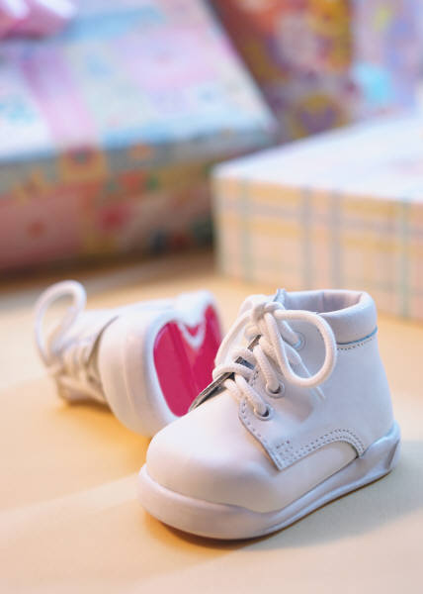

HOMOPHONES pair-pear
KAH 2015 UAP

Slide 6


HOMOPHONES see-sea
KAH 2015 UAP

Slide 7
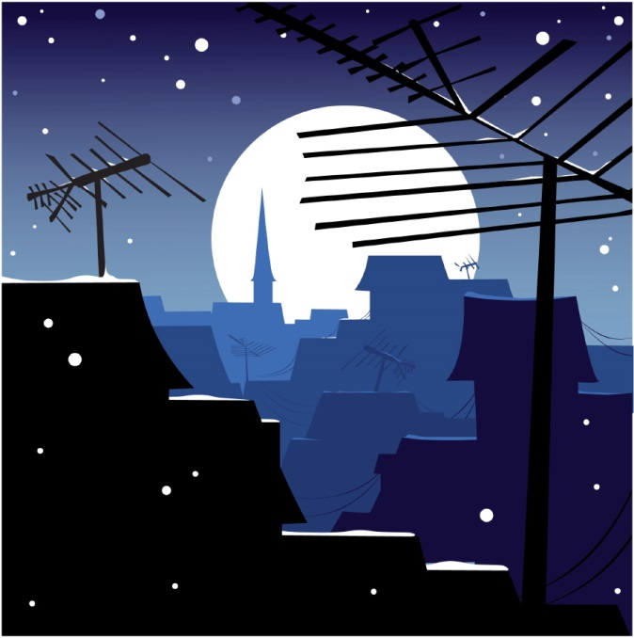

HOMOPHONES night-knight
KAH 2015 UAP

Slide 8
Homonym
Nym = name
Pseudonym = fake name
Homonyms = same name
Words that sound the same and have the same spellings are homonyms.
KAH 2015 UAP

Slide 9
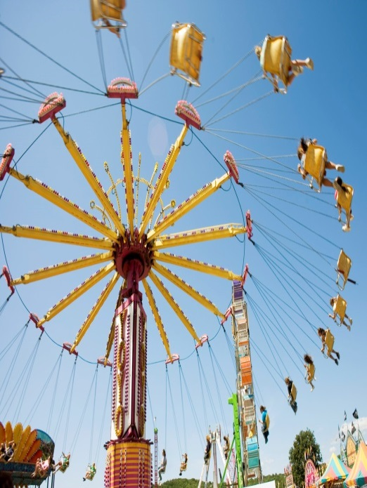

HOMONYMS fair-fare
KAH 2015 UAP

Slide 10

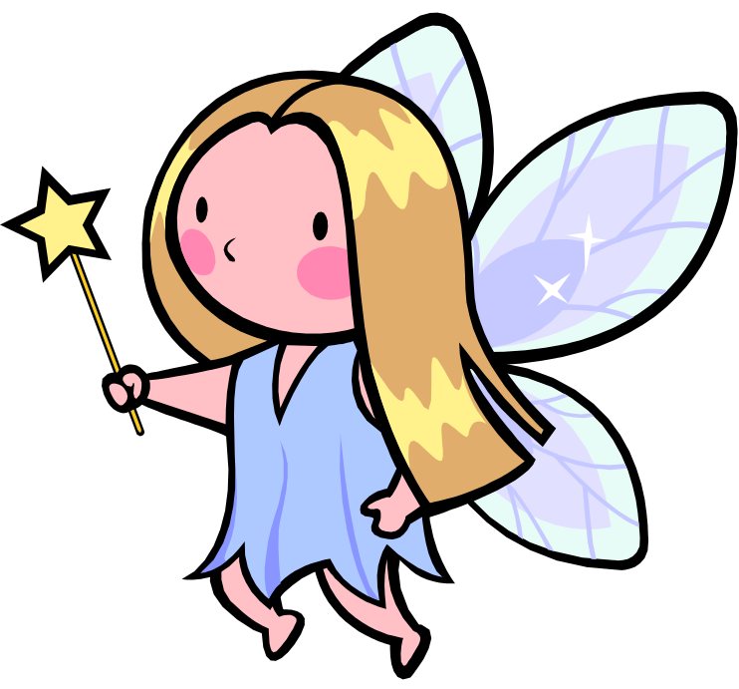
HOMONYMS ferry-fairy
KAH 2015 UAP

Slide 11


HOMONYMS die-dye
KAH 2015 UAP

Slide 12
Homographs
graph = writing
biography = life writing
homograph = same writing
Words that have the same spellings but sound different are homographs.
KAH 2015 UAP

Slide 13
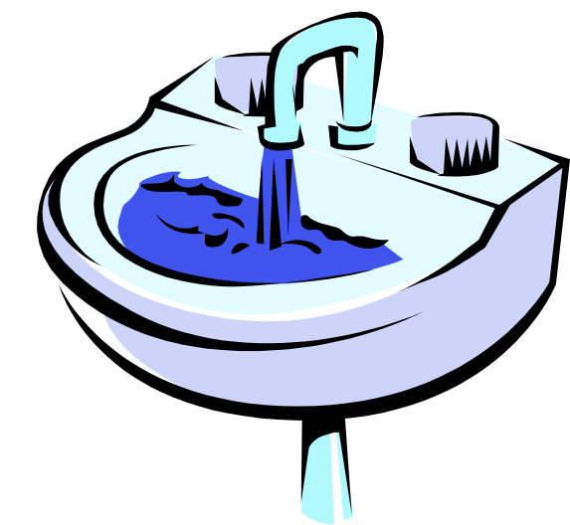

HOMOGRAPHS sink-sink
KAH 2015 UAP

Slide 14

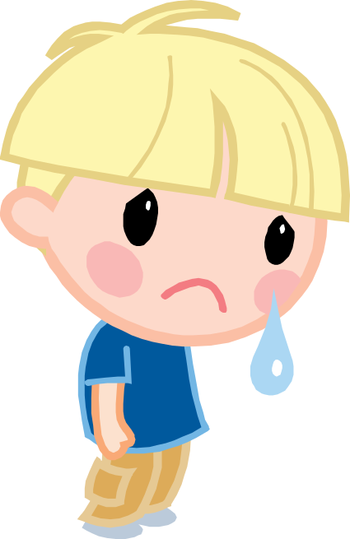
HOMOGRAPHS tear-tear
KAH 2015 UAP

Slide 15

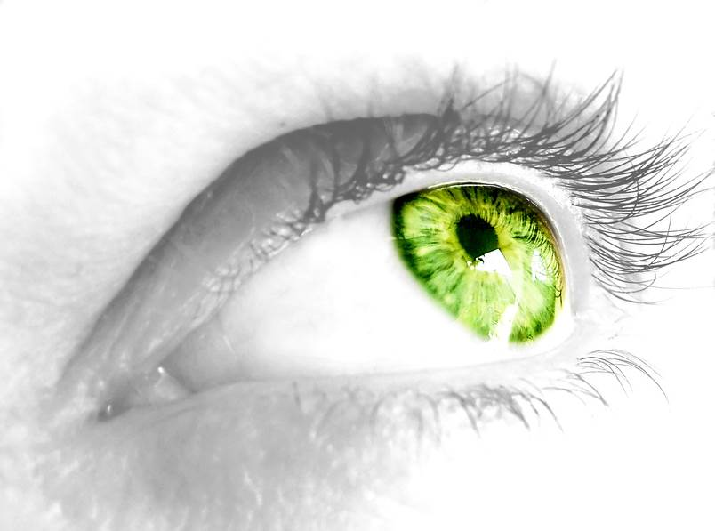
HOMOGRAPHS saw-saw
KAH 2015 UAP

Slide 16
REFRENCE
1. www.ereadingworksheets.com
2. www.slideshare.net

